Slide 1
Attosecond spectroscopy : Accessing ionization dynamics through a Fano resonance
ATTO group
Christina Alexandridi
Thesis director : Pascal Salieres
Attolab meeting
02/12/2016

Slide 2
Autoionization in Helium
Autoionization state= excited state empended in the continuum
E[eV]
$$σabs$$
Doubly excited state 2$s2p$
60.15
He
Asymmetric peak
N=1
He
${He}^{+}$ 1$s^{1}$
Ip=24.58
He
He 1$s^{2}$
U. Fano, Phys. Rev. 124, 1866 (1961)

Slide 3
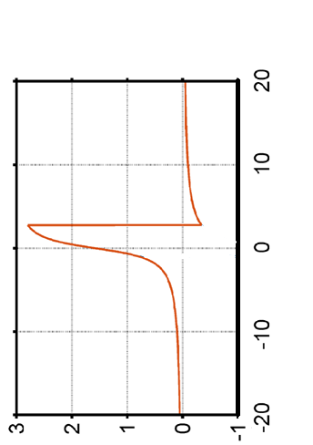
Fano resonance: cross section and scattering phase
Domke et al., 1996
U. Fano PRA, 1961
Configuration Interaction
Γ=$\frac{1}{τ(17fs)}$=37meV
Scattering Amplitude
Fano profile
$$R(ε)=\frac{q+ε}{ε+i}$$
q=-2.77
$${\left|R\left(ε\right)\right|}^{2}=\frac{{\left(q+ε\right)}^{2}}{1+ε^{2}}$$
Reduced energy
$$ε=\frac{E−Er}{\frac{1}{2}Γ}$$
Scattering phase
$$η_{scat}=arg⁡[R\left(ε\right)]$$
η _{scat} [rad]
ε

Slide 4
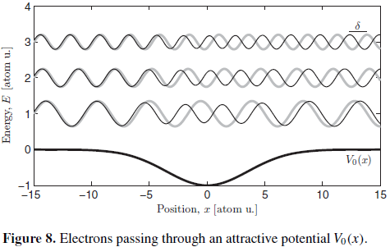
Scattering phase
Phase de diffusion
η
Ionization time delay :
(Wigner time delay)
E. P. Wigner, Phys. Rev. (1955)
η _{scat} [rad]
Délai introduit par une résonance intermédiaire ?
ε
4

Slide 5
Spectrally-Resolved Electron Interferometry
RABBIT
SB oscillations
$$φ_{H39}−φ_{Η37}$$
Scattering phase

Slide 6
Spectrally-Resolved Electron Interferometry
RABBIT
He 2s2p
FFT
SB₆₂
Gruson et al.,Science,2016
Colloque UVX 2016
8

Slide 7
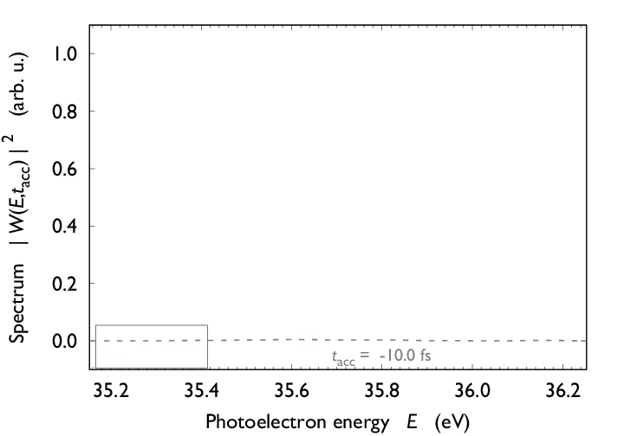
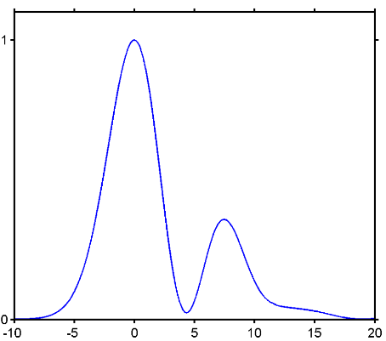
Access to the ionization dynamics
Amplitude
$$| TF−1\{\int_{−∞}^{tf}{ψ\left(t\right)e^{−iφ(t)}dt\} |²}$$
Fourier Transform
Phase
$$|ψ\left(t\right)|²$$
Photon Energy
$$tf$$
Gruson et al., Science,2016

Slide 8
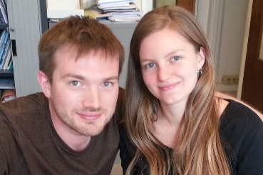
Accessing the scattering phase
PLFA @ CEA-Saclay ,2015
Vincent Gruson
Lou Barreau
Reconstruction resonant EWP dynamics for 2s2p Helium [Gruson et al.,Science,2016]
Higher electron spectrometer resolution
(sub 100 meV)
Investigation of other resonances:
Helium
Argon
LaserLAB campaign @ Lund University, Feb+Apr 2016
Margherita Turconi
Lou Barreau
M.Isinger, A. Harth , D. Kroon, D. Busto, S. Plogmaker, et A. L’Huillier

Slide 9
Scattering phase of He 2s2p Fano resonance
lk
SB38
H39
SB38
SB38
Delay XUV-IR [fs]
Fourier Transform extraction of 2$ω_{o}$ peak
Delay XUV-IR [fs]
SB38
Reproducibility of PLFA data
Better resolved phase jump
Photon energy [eV]
Photon energy [eV]

Slide 10
Coherent excitation of both 2s2p and sp3+ in He
Tunable IR with DAZZLER
Γ=$\frac{1}{τ(77fs)}$=8.2meV
q=-2.58
Coherent excitation of 2e- EWP

Slide 11
Coherent excitation of both 2s2p and sp3+ in He
H39
SB40
SB40
H41
safas
SB40
Spectrometer resolution=150meV
Delay XUV-IR [fs]
Delay XUV-IR [fs]
Signature of 2e- EWP
SB40
sp3+
2s2p
Photon energy [eV]
Photon energy [eV]

Slide 12
Scattering phase of Ar 3s¹3p⁶4p
Chan et al., 1992
E [eV]
26.6
|$\left.\text{3}s^{1}3p^{6}4p\right\rangle$
$$E_{r}$$
SB16
Γ=$\frac{1}{τ(8.6fs)}$=76meV
H17
IR
q=-0.25
H15
J=3/2
$$σabs$$
15.94
S-O=180 meV
15.76
J=1/2
0
|$\left.\text{[}\text{Ne}\text{]3}s^{2}3p^{6} \right\rangle$

Slide 13
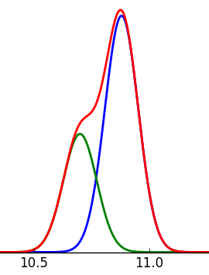
Scattering phase of Ar 3s¹3p⁶4p
H17
H19
Non resonant
J=3/2
H19
J=1/2
180meV
total
Delay XUV-IR [fs]
30
Photon energy [eV]
resonant
H17
J=3/2
Photon energy [eV]
J=1/2
total
Complicated line shapes
26.2
26.7
Photon energy [eV]

Slide 14
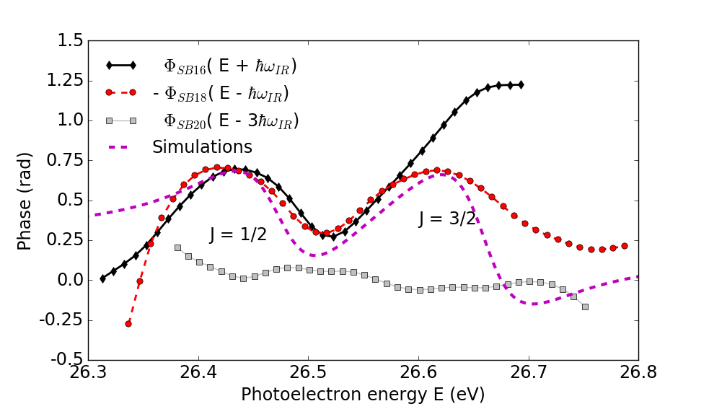
Scattering phase of Ar 3s¹3p⁶4p
SB16
SB16
H17
SB18
SB18
SB16
SB18
SB16
Delay XUV-IR [fs]
$η_{scat}$ resolved for both S-O components
Delay XUV-IR [fs]
-SB18
SB16
SB18
SB20
simulation
Photon energy [eV]
Photon energy [eV]

Slide 15
CONCLUSIONS
Spectrally resolved RABBIT→ unique insight into e-e correlation.
Determination of $η_{scat}\left(E\right)$ for He (2s2p,sp3+).
Resolved Fine structure in Argon.
OUTLOOK
Temporal reconstruction of complex 2e-EWP (2s2p+ $sp_{3}^{+})$ in Ηe.
Investigation of more complex systems (Nitrogen, different types of resonances)
From observation to control→ Increase IR intensity .
Angular resolution for the 4D reconstruction (time+space) of the EWP

Slide 16
LIDyL/ATTO
L.Barreau, M. Turconi, Α. Βorot, B. Carré, P. Salières
Merci pour votre attention !
Attophysics group/University of Lund
M.Isinger, A. Harth , D. Kroon, R. Squibb,D. Busto, S. Plogmaker, R.Feifel, A. L’Huillier
LCPMR, Paris
F. Risoud, J. Caillat, R. Taïeb, A. Maquet
Universidad Autónoma de Madrid
Á. Jiménez Galán, L. Argenti, F. Martín

